Slide 1
Glioblastoma

Slide 2
Outline
Intro
Molecular vs. Histology
Treatment: XRT, additional treatments, subgroup: Elderly
Assessing Treatment Response
Studies

Slide 3
GBM papers
Elderly gbm: ROA study. Roa et al JCO 2004.
Elderly gbm: >60yo. Malmstrom A et al Lancet Oncology 2012.
Elderly GBM: >65yo. NOA-08. Wick W et al Lancet oncology 2012.
Elderly GBM: CCTG/EORTC/TROG. Perry et al NEJM 2017
After treatment pseudoprogression: Brandes et al JCO 2008.
RANO: response assessment in Neuro-oncology Criteria. Wen PY et al JCO 2010. Okada et al Lancet Oncol 2015.
Louis DN, Perry A, Reifenberger G. et al. Acta Neuropathol 2016
BRAT The Cancer Genome Atlas Research NEJM 2015
Brat DJ et al Acta Neuropathologica 2018
Stupp NEJM 2005
Stupp et al Lancet 2009
Stupp et al JAMA 2017
Herrlinger, Tzaridis et al Lancet 2019 (NOA-09)
NRG BN001
ASTRO contouring guideline consensus
ESTRO contouring guideline consensus
Notes:
H3 K27 and H3 G34 distinct from IDH-wt GBM

Slide 4
NCCN 2019 guidelines

Slide 5
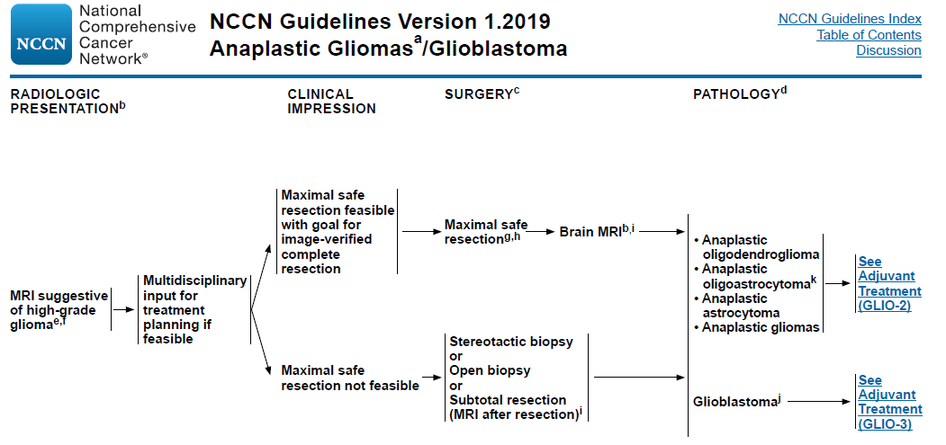

Slide 6
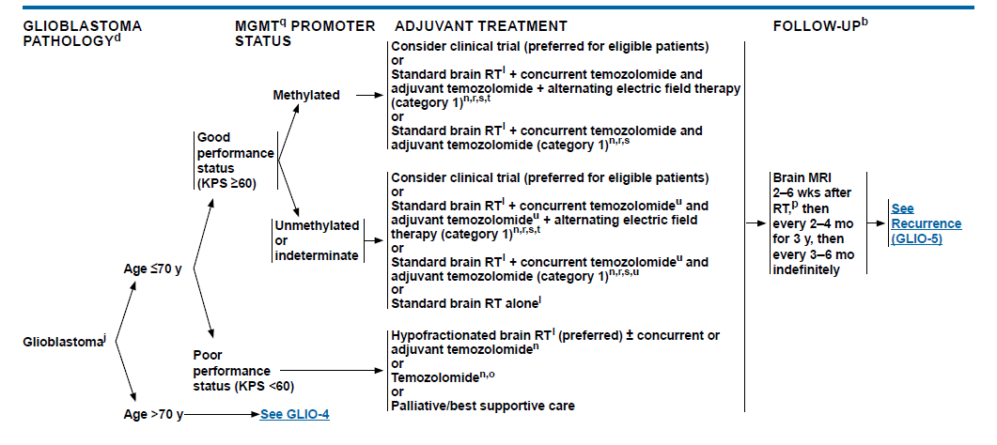
TTF, TMZ
Lomustine added 2019
65 yo subgroup

Slide 7
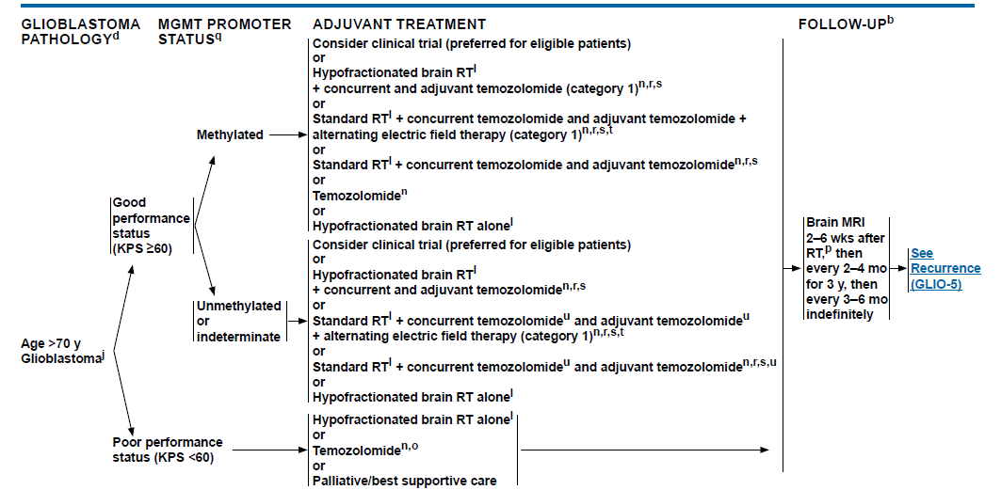

Slide 8
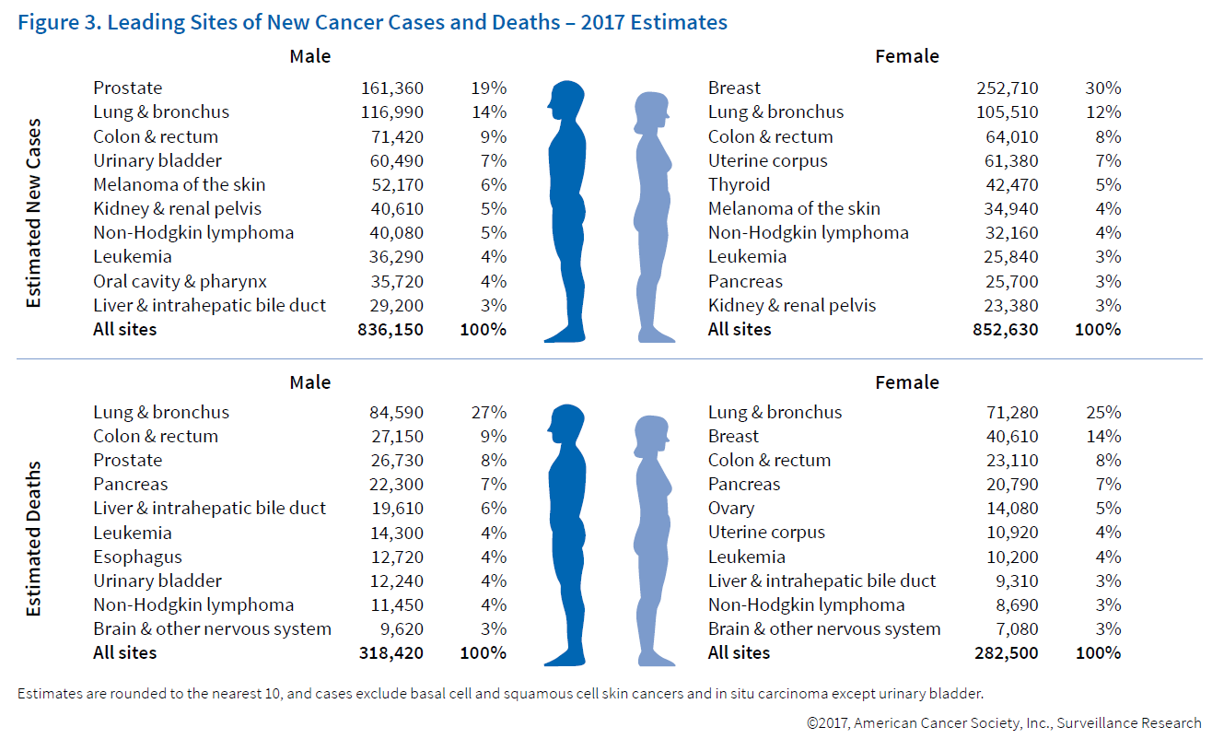

Slide 9
MRI intro
MRI sequences
T1- enhances fat and soft tissues, does not enhance fluid
T1 with contrast- Ideal for visualizing brain tumors
“white matter is white on T1”
T2 enhances fluid such as CSF, edema (does not enhance fat)
FLAIR- removes increased CSF signal on T2, shows abnormal fluid
Identifies mass and edema
FLAIR = FL Attenuated Inversion Recovery
Notes:
White matter connects, grey matter has the astrocytes, oligodendroglial cells

Slide 10
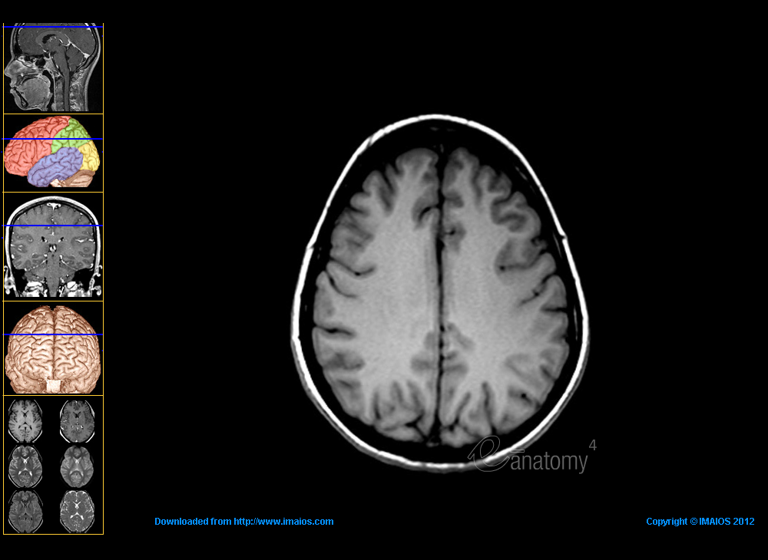
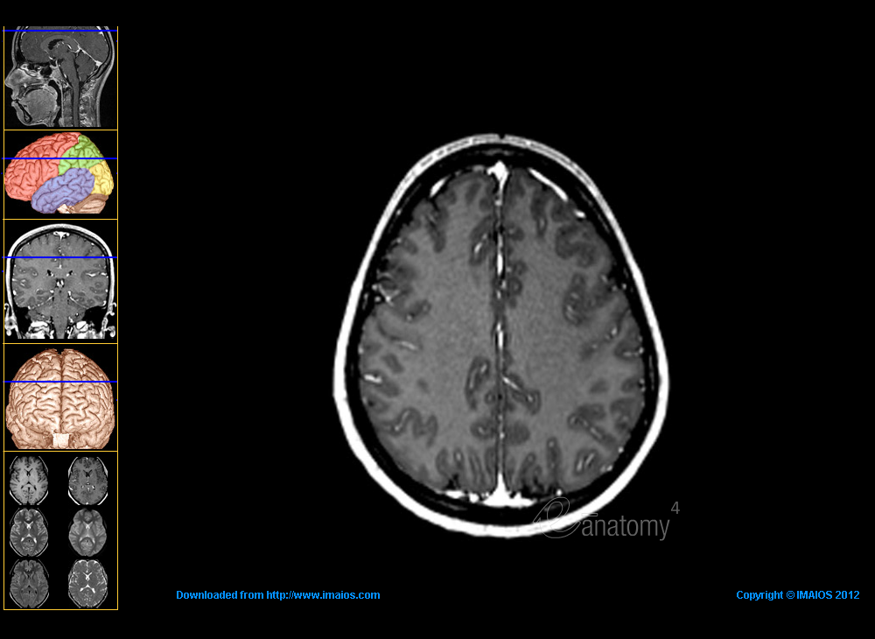
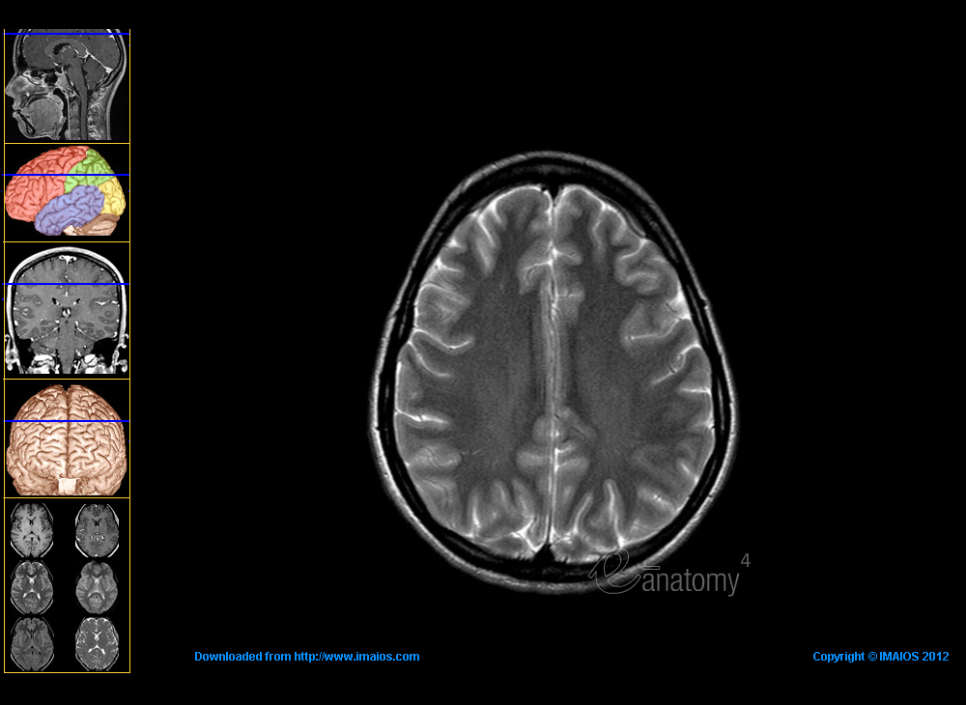
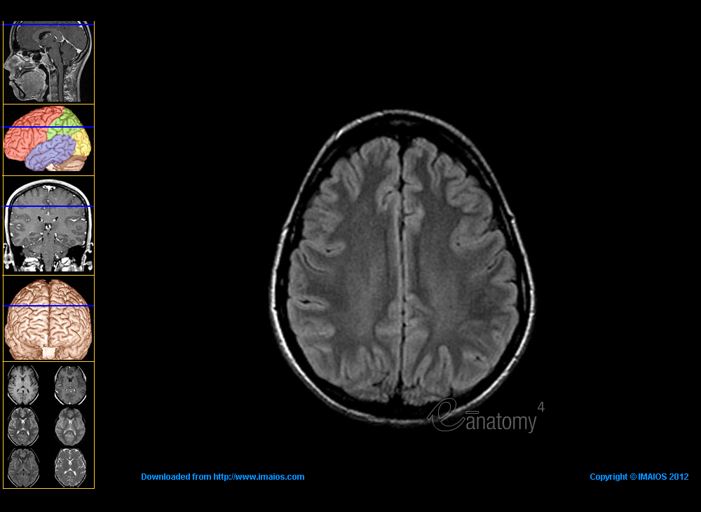
T1+
T1
What
Phase
are the
MRIs?
T2+
FLAIR

Slide 11
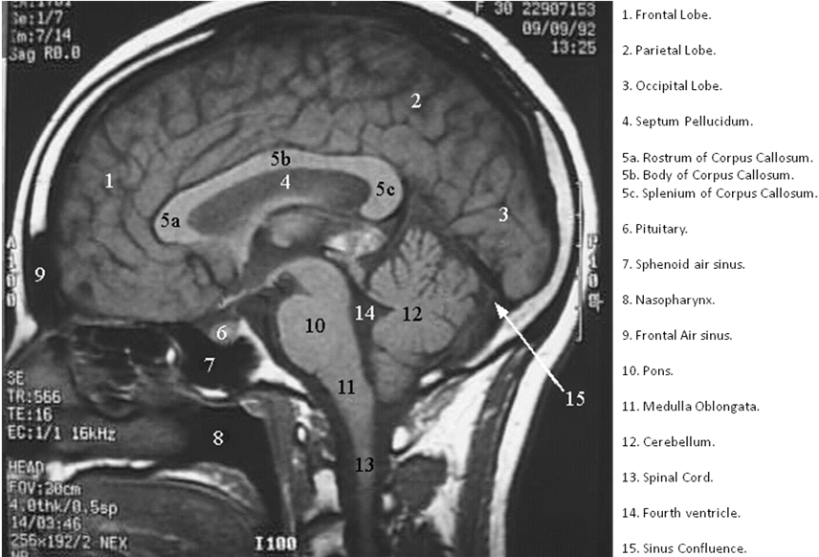

Slide 12
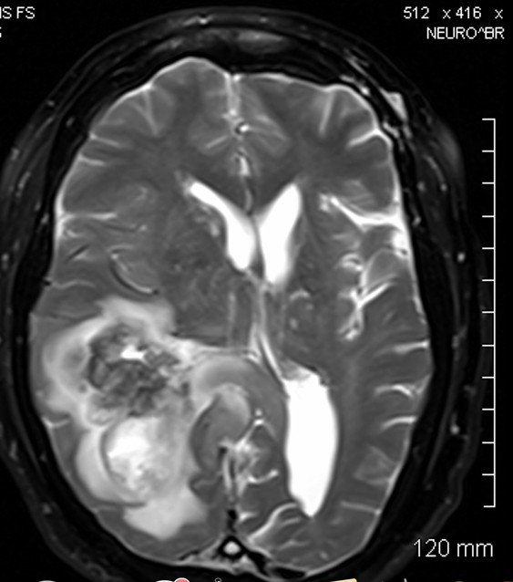
Case example

Slide 13
What is the differential diagnosis?

Slide 14
DDx supratentorial enhancing lesion:
MAGLA
Metastasis
Anaplastic astrocytoma
GBM
Lymphoma
Abscess
Also: low grade gliomas (ganglioglioma, JPA), meningioma, infarction)

Slide 15
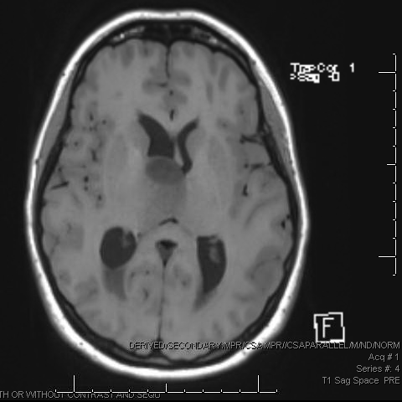
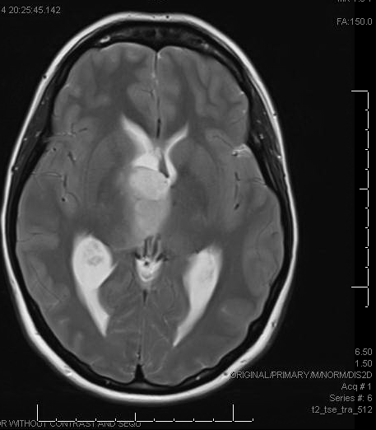
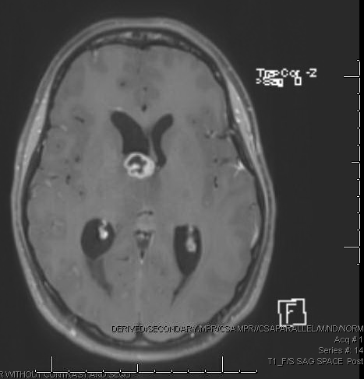
Imaging: MRI
T1 Pre
T2 TSE TRA
T1 Post FS
T1Weighted: hypo-isointense mass compared to gray matter
T2Weighted: heterogenous, hyperintense with adjacent infilitration/vasogenic edema T2 FLAIR: heterogenous, hyperintense with adjacent tumor infiltration + vasogenic edema
T1 post contrast: Central necrosis surrounded by irregular enhancement (vascularity) “ring-like”

Slide 16
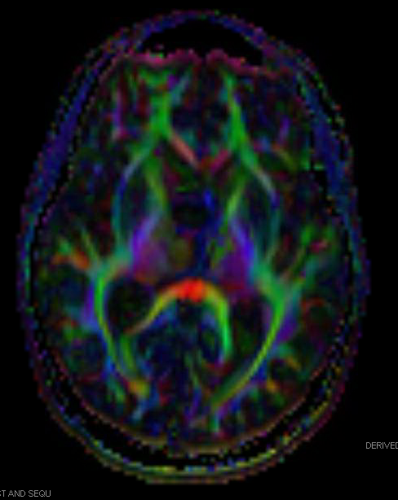
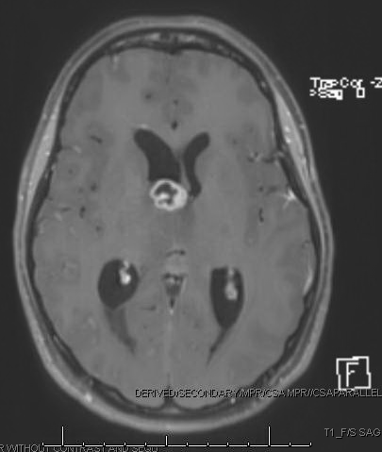
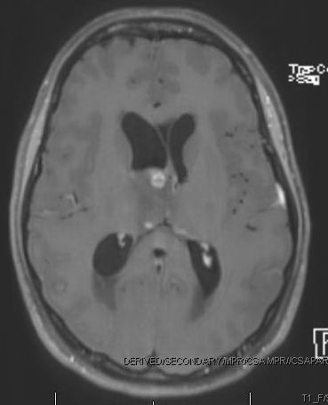
Additional Imaging
Diffusion
T1 Post FS
T1 Post FS
Diffusion DTI: void seen over mass area
Notes:
White matter tracts

Slide 17
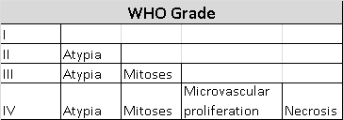

Slide 18
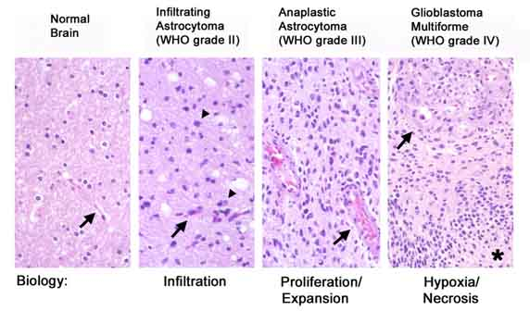
Pathology
AMEN
Atypia
Mitosis
Endothelial proliferation
Necrosis
Atypia
www.bioscience.org
Notes:
Histopathologic progression of infiltrating astrocytoma (WHO grade II, left) to glioblastoma multiforme (GBM; WHO grade IV, right).
In grade II infiltrating astrocytomas, individual tumor cells percolate through CNS parenchyma (arrowheads). Vascular architecture and density are similar to that in normal brain white matter (arrows).
Astrocytoma cells become more numerous, atypical, and show occasional mitotic figures in anaplastic astrocytoma (AA; WHO grade III). Vessels in AA are more numerous and often are dilated or have thickened walls (arrows).
In glioblastoma multiforme, microvascular hyperplasia, including glomeruloid vascular proliferation (arrow), and necrosis with pseudopalisading tumor cells are seen (asterisk within necrotic center). Microvascular hyperplasia is often noted in zones surrounding pseudopalisading necrosis.

Slide 19
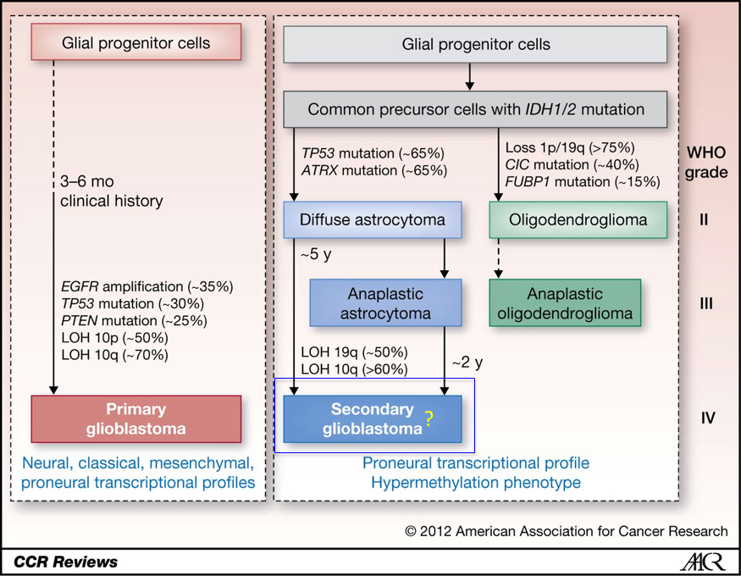
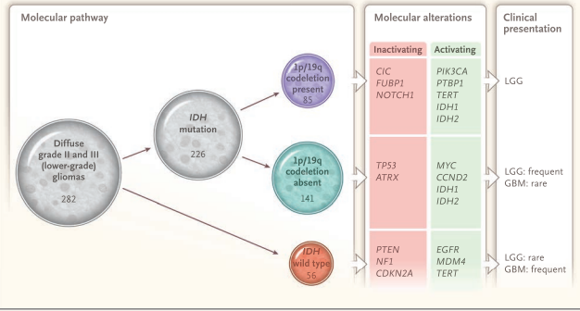
Molecular Pathways
Notes:
IDH normally converts isocitrate -→ a-KG and NADPH
IDH1/2 mutants (R132H) ineffectively bind isocitrate, but actually can act upon a-KG and end up producing (D)-2-hydroxyglutarate (D2HG) Non-mutant enzyme produces the mostly the L-isoform.

Slide 20
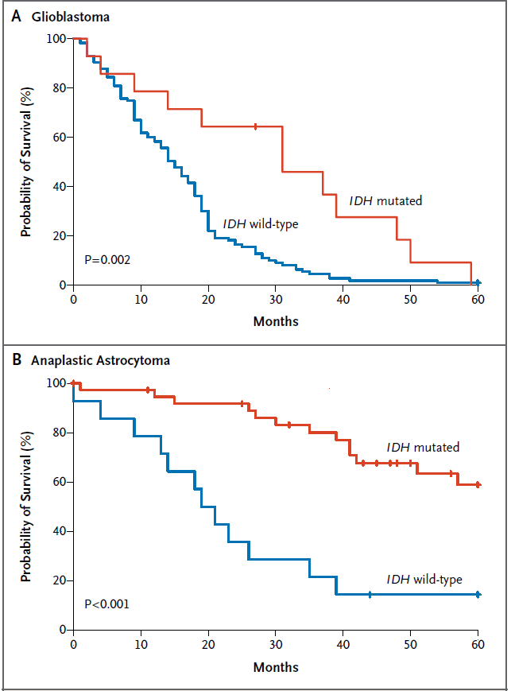
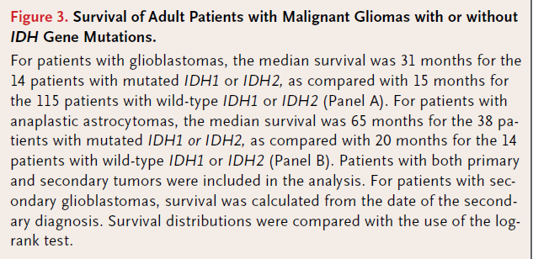
Survival
Better with IDH mutations in both:
GBM
Median OS: 15m → 31 m
AA
Median OS: 20m → 65m

Slide 21
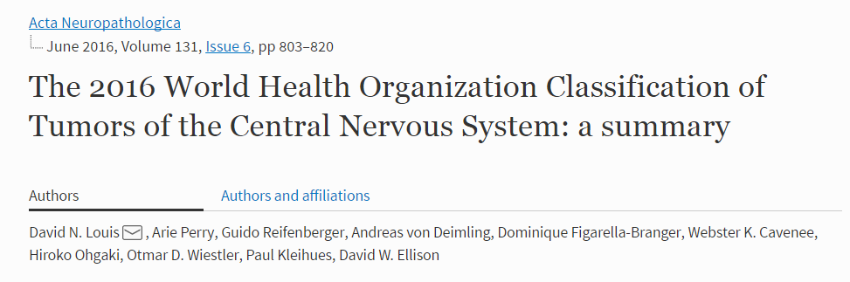

Slide 22
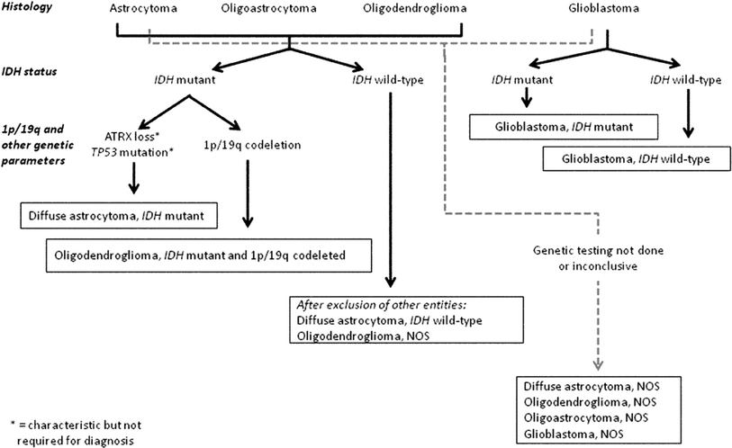

Slide 23
IDH and GBM (Louis, Perry WHO 2016)
IDH wt GBM
60yo
90% GBM
No precursor lesion
4mo clinical hx
15mos MS
Extensive necrosis
+TERT mutation
EGFR amp
PTEN mut
IDH mut GBM
40yo
10% GBM
Precurso diffuse astrocytoma
1yr clinical hx
31mos MS
Limited
P53 mutations
ATRX mutations

Slide 24
Grade IV:
Glioblastoma multiforme 1 year
Anaplastic astrocytoma 3 years
Low grade astrocytoma 5 years
Low grade mixed oligoastrocytoma 7.5 years
Oligodendroglioma 10 years

Slide 25

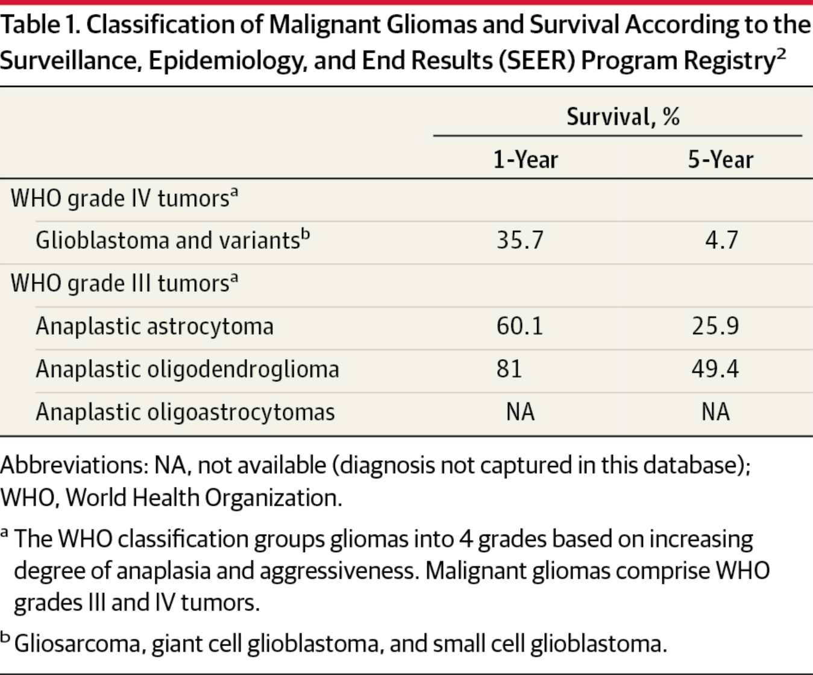
From: Glioblastoma and Other Malignant Gliomas: A Clinical Review
JAMA. 2013;310(17):1842-1850. doi:10.1001/jama.2013.280319
Figure Legend:
Classification of Malignant Gliomas and Survival According to the Surveillance, Epidemiology, and End Results (SEER) Program Registry
Notes:
Historical data: now can add 2 years (except for GBM)
Grade II astro and grade III oligo have the same survival ie 5 years
Add 2 yrs to OS for AA: RTOG 9402 5 yrs for those without 1p19q codeletion
Malignant glioma RPA (I 5 yr, II 3yr, III 1.5 yr, 1 yr IV and 7.5 mo V and VI)
AA → 5 yr or 3 year determined by age (50)
GBM → 0.5 yr (> 50 yo) or 1-1.5 yr (< 50, KPS 90 or not)

Slide 26
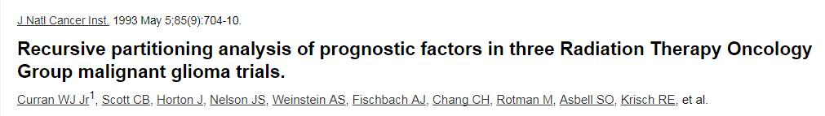
RTOG RPA Class (original for grade 3,4)

Slide 27
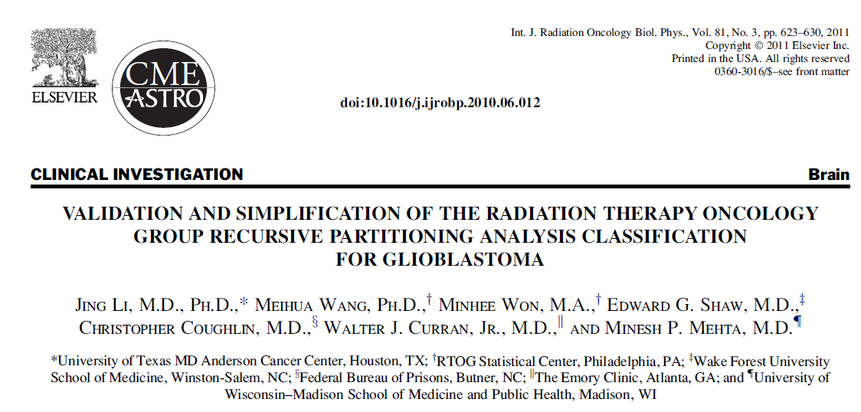
GBM-specific RPA

Slide 28
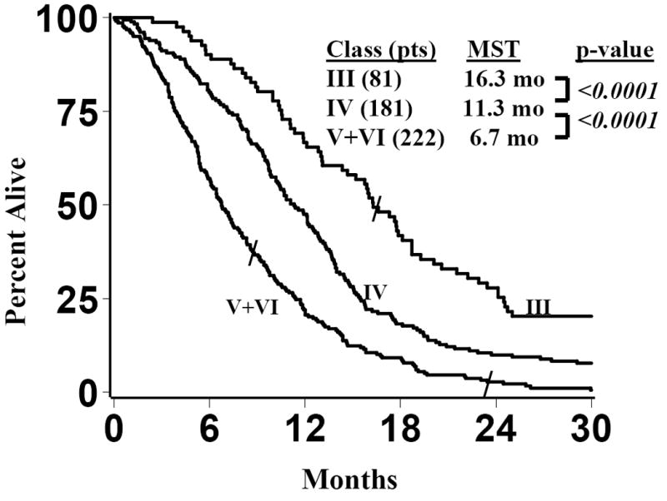
Jing Li et al. IJROBP 2011

Slide 29
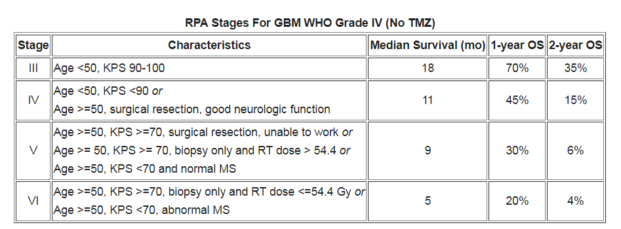
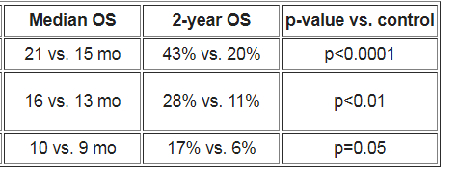
RPA before/after TMZ era
With TMZ vs without

Slide 30
Alkylating agents and brain tumors
Carmustine = bcnu
Lomustine
Fotemustine
Procarbazine
Temozolomide
Add alkyl group to DNA, trigger DNA repair and apopstosis

Slide 31
temozolomide
Oral alkylating agent
TMZ methylates DNA at N7 methylguanine and N3 methyladenine → repaired by BER which is efficient (BER=base excision repair)
Only 5-10% methylate at o6 methylguanine (MGMT)-> DNA mismatch repair MMR pathway which is cytotoxic
Deplete Neutropenia
Thrombocytopenia
Lymphocytopenia (risk of PCP use bactrim or inhaled pentamidine)
TMZ induces cell cycle arrest in G2M most radiosensitive phase

Slide 32
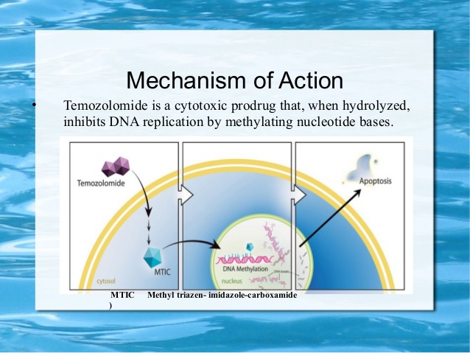
TMZ
Oral pill:
→ rapidly absorbed, passes the blood-brain barrier.
Pharmokinetic / mechanism:
#1- Hydrolysed to ‘active’ metabolite: “MTIC”
Methyltriazeno-imidazole-carboxamide
#2- MTIC methylates DNA at several positions, the “goal” of methylating at O6 position of guanine = “cell-lethal lesion”
This can be repaired by the cell though, with the use of “MGMT” (called a suicide DNA repair enzyme b/c it only can be used once)
Thus: if MGMT deficient, then less able to repair the effect of TMZ !

Slide 33
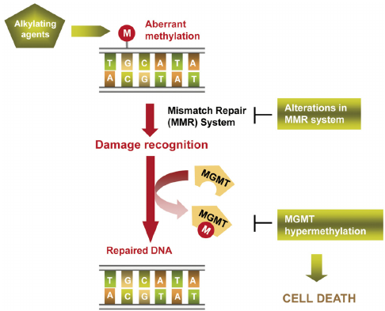
MGMT
MGMT is a DNA repair enzyme that may cause resistance to DNA-alkylating drugs
MGMT=O-methylguanine methyltransferase
Methylation (of the promoter genes) causes decreased MGMT, which is an enzyme that repairs DNA damage caused by alkylating agents
Pts with MGMT promoter methylation have improved survival with TMZ

Slide 34
MGMT methylation = less MGMT
MGMT = dna repair enzyme o6-methylguanine-dna methyltransferase (MGMT)
MGMT methylation silences the MGMT gene (epigenetic silencing)
MGMT repairs DNA damages by alkylating agents
Relative expression of MGMT affects OS and PFS
MGMT meth and TMZ do better OS and PFS

Slide 36
WBRT and GBM

Slide 37
XRT for GBM: MRC trials 60 Gy (30 fx) better than 45 (20 fx)
Bleehan BJC 1991
Phase 3 randomized
Surgery then RT
60 Gy: median OS = 12 m
45 Gy: median OS = 9 m

Slide 38
Role for SRS boost?.... Not for Denovo

Slide 39
Surgery EOR
Lacroix (MDACC):
Sanai (UCSF):
Chaichana (Hopkins): looked specifically at butterfly tumors
Conclusion: retrospective series show that extent of resection correlates to survival.

Slide 40
Original Stupp Trial (XRT+/- TMZ in new GBM) (Stupp et al NEJM 2005)
Eligible:
18-70 yo
New GBM
ECOG 0-2
ANC >1.5
Liver and kidney function
2-3 cm margin of the T1post con
XRT 60Gy
TMZ 75mg/m2 concurrent and 6 cycles adjuvant of 150-200mg/m2
OS
PFS
Toxicity
1st MRI: one month post chemoxrt
MS 12.1 mos vs 14.6 mos (1 year PFS 9% vs. 27%)
2 yr OS 10.4% vs. 26.5%
7% grade 3 or grade 4 heme toxicity, constipation other toxicity common
80% surgery, 20% biopsy only
Notes:
Patients have asked me for this treatment off trial ala STOMP
Randomized phase II Trial
Ct/bone scan & 18F or 11C-choline PET-CT or MRI

Slide 41
5yr Stupp Trial update (XRT+/- TMZ in new GBM) (Stupp et al Lancet Oncol 2009)
Eligible:
18-70 yo
New GBM
ECOG 0-2
ANC >1.5
Liver and kidney function
2-3 cm margin of the T1post con
XRT 60Gy
TMZ 75mg/m2 concurrent and 6 cycles adjuvant of 150-200mg/m2
OS
PFS
Toxicity
1st MRI: one month post chemoxrt
2 yr 27%, 3 yr 16%, 4yr 12%, 5yr 10% in chemoXRT
2yr 11%, 3yr 4%, 4yr 3%, 5yr 2% XRT alone
MGMT strongest predictor
Bx only worst
Even MGMT unmethylated still benefit from TMZ xrt but very very few patients
Notes:
Patients have asked me for this treatment off trial ala STOMP
Randomized phase II Trial
Ct/bone scan & 18F or 11C-choline PET-CT or MRI

Slide 42
Stupp Trial + TTF (Tumor-treating fields) (Stupp et al JAMA 2017)
Eligible:
GBM
All received standard chemoxrt (60Gy)
KPS >70
>18yo
20% >65yo (so some elderly on trial)
Maintenance TMZ vs. TTF+TMZ
1st PFS
2nd OS
TTF: tumor treating fields, novocure, 200kHz frequency, alternating electric fields, >18hrs/day, 4 transducer arrays
Anti-mitotic, mitotic arrest and apoptosis.
Single studies comparing ttf to salvage chemo showed more ORR 12% vs. 7%
Swimming cap + backpack, shave head
MS 20.9 mos vs. 16mos
PFS 6.7 mos vs. 4 mos
Toxicity 48% vs. 44%
Median: 8 mos of TTF treatment (range 0-82mos), 50% continued TTF After 1st progression
Notes:
Patients have asked me for this treatment off trial ala STOMP
Randomized phase II Trial
Ct/bone scan & 18F or 11C-choline PET-CT or MRI

Slide 43
Can we make chemo better? Lomustine
Nitrosurea
Crosses BBB
Bifunctional agent: dna alkylator and non-alkylating: interstrand crosslinks and carbamoylation of amino acids
Phase II single arm: 31 plts MS 23 mos vs. 15-17mos. But exclusive in MGMT methylated where MS 34.5 vs 23.4 mos (MGMT unmethylated still 12.5 mos)
So did phase III: NOA-09
Lomustine side effects: liver toxicity!! And vascular events (stroke, PE)

Slide 44
NOA-09 Lomustine-temozolomide vs. TMZ in MGMT methylated New dx GBM pts (Herrlinger et al Lancet 2019)
Eligible:
New GBM or gliosarcoma
18-70yo
Mgmt methylated
KPS >70
Steroid stable
XRT 59-60Gy (30-33fx) concurrent with
TMZ (75 mg/m2)
Vs TMZ+lomustine (weekly tmz 100mg/m2, lomustine 100mg/m2)
OS
PFS
Toxicity
Small sample size 141 patients
Prior phase II single arm showed benefit to TMZ+lomustine
Median OS: 31.4mos TMZ vs. 48.1 mos TMZ+lomustine (PFS still same 16.7mos so maybe need another modified RANO! i.e. later pseudoprogression with combination therapy)
Grade 3 toxicity 51% TMZ (60% completed all 6 cycles) and 59% TMZ+lomustine (40% completed all 6 cycles)
<55 yo and no IDH mutation of the common IDHArg132His then had more extensive IDH mutant screening, if another IDH mutant found then also did 1p19q sequencing!
IDH wt patients also improved!
Some concern about long term hemorrhage risk (at ARS 2019 the stanford neuroonc not using yet)
Notes:
Patients have asked me for this treatment off trial ala STOMP
Randomized phase II Trial
Ct/bone scan & 18F or 11C-choline PET-CT or MRI

Slide 45
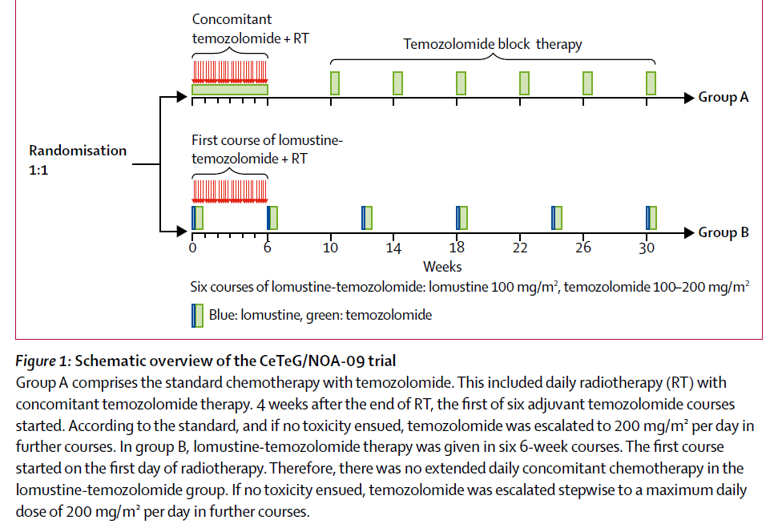
NOA-09

Slide 46
RTOG 0825: any role of bevacizumab?

Slide 47
Elderly GBM Early hypofx paper (Roa et al JCO 2004)
Eligible:
>60 yo
GBM
XRT 40Gy/15fx
Vs.
XRT 60Gy (1.8-2Gy)
Preop
Edema 46Gy 2cm margin
Or no edema t1postcon 2.5cm
14Gy t1post con 2.5cm
1: OS
Toxicity
MS: 5.1 mos 60Gy vs. 5.6mos hypofx XRT
6mos OS 45% vs. 42% (hypofx)
50% in 60GY arm required increase in steroids vs. 23% in hypofx arm
KPS similar between arms
26% in 60Gy did not complete vs. 10% in hypofx arm
Hypofx for elderly

Slide 48
NOA-08 Trial (TMZ vs. XRT alone for elderly >65yo) (Wick et al Lancet 2012)
Eligible:
>65 yo
Grade III AA
GBM
KPS >60
TMZ 100mg/m2 x 6 cycles
Vs.
XRT 60Gy (1.8-2Gy), 2cm margin
1: OS
Toxicity
Non-inferiority trial
Median OS: 8.6mos TMZ alone vs. 9.6 mos XRT alone
PFS 3.3 mos vs. 4.7 mos (TMZ vs. XRT)
MGMT meth do better with temozolomide 11.9 vs. 8.2 mos
Non MGMT meth do better with xrt 3.3 vs 4.6 mos
Elderly: TMZ alone non inferior to XRT alone (MGMTmeth could do TMZ alone)
TMZ cycles (25% received over 10 cycles!)

Slide 49
Nordic Trial (TMZ vs. 6wk XRT vs. hypofx XRT), >60yo (Malmstrom et al Lancet 2012)
Eligible:
>60yo (** ½ way through >65yo, subgroup >70)
KPS 0-2 (neuro KPS 3)
ANC 1.5
Plt 100
Hgb 10
AST/ALT wnl
TMZ 200mg/m2 x 6 cycles
Vs.
34Gy/3.4Gy
Vs.
60Gy/2Gy
1: OS
Toxicity
Median OS: 6mo (60Gy) vs. 7.5mos (34Gy) vs. 8 mos (TMZ). Only TMZ SS compared to 60Gy, TMZ vs. 34Gy similar Median OS. >70yo then 34Gy = TMZ for OS
TMZ alone for methylated longer OS 9.7mos vs. 6.8mos (no difference with XRT and MGMT)
30% biopsy only, 70% some resection
Better prognosis: KPS2 1.4 HR, surgery/bx 1.5 HR, age >70 1.3 HR
Interaction between age and treatment
Only 30% completed all 6 TMZ cycles, 72% 60Gy, 95% 34Gy
MGMT 50% methylated, IDH Arg132His mutation rare

Slide 50
TMZ+short course xrt in Elderly GBM (Perry NEJM 2017)
Eligible:
>65yo
ECOG 0-2
GTV T1postcon
CTV T1postcon+1.5cm
PTV 5mm
40.05Gy/15fx
Vs.
40.05Gy/15fx +TMZ 75mg/m2 and adj TMZ 12cycles
OS
PFS
Toxicity
Median OS: 40Gy 7.6mos vs . 40Gy+TMZ 9.3mos (MGMTmeth 7.7 vs 13.5 mos **doubled, no MGMTmeth 7.9 vs 10mos) (2yrs 4% vs. 18% for MGMTmeth)
PFS 3.9 vs 5.3 mos (short!!)
70% resection, 30% biopsy only (HR biopsy 1.67)
50% MGMT meth
65 yo did worse than 70 yo – maybe because 65 eligible for trial unfit per physician for 6 weeks…
Notes:
Patients have asked me for this treatment off trial ala STOMP
Randomized phase II Trial
Ct/bone scan & 18F or 11C-choline PET-CT or MRI

Slide 51
TTF
Soltys GBM, LARS, ASTRO

Slide 53
After treatment how to interpret MRI?
Old Macdonald criteria
Based on RECIST:
25% tumor (2D measure), new lesions, steroids

Slide 54
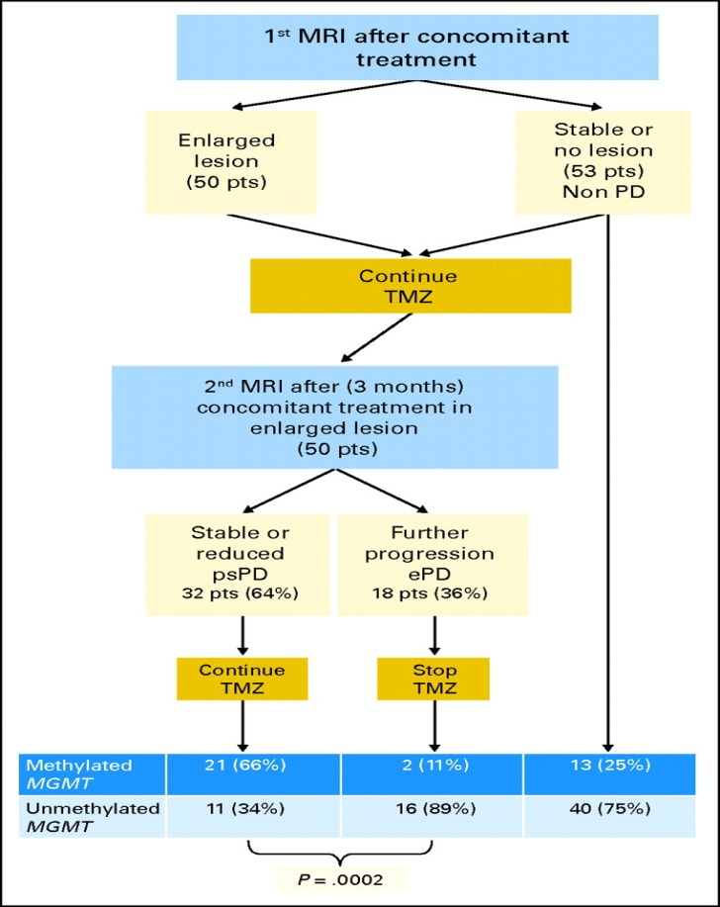
How do we interpret MRI post chemoxrt?
Fig 1. MRI findings, outcomes and MGMT status of patients. MRI, magnetic resonance imaging; PD, disease progression; TMZ, temozolomide; psPD, pseudoprogression; ePD, early disease progression; MGMT, O6-methylguanine–DNA methyltransferase.
Published in: Alba A. Brandes; Enrico Franceschi; Alicia Tosoni; Valeria Blatt; Annalisa Pession; Giovanni Tallini; Roberta Bertorelle; Stefania Bartolini; Fabio Calbucci; Alvaro Andreoli; Giampiero Frezza; Marco Leonardi; Federica Spagnolli; Mario Ermani; Journal of Clinical Oncology 2008 262192-2197.
DOI: 10.1200/JCO.2007.14.8163
Copyright © 2008

Slide 55
MGMT promoter methylation status and pseudoprogression (Brandes et al JCO 2008): How do we interpret MRI post chemoxrt?
Background.
OS looks better than PFS
5 vs. 7 mos PFS though 2yr OS 11% vs. 27%
Overestimate disease progression
Pseudoprogression (psPD): therapy-induced necrosis = rupture of hematoencephalic barrier
XRT Disrupts BBB
XRT+TMZ, TMZ planned for 12 cycles
MRI SEQUENCING:
MRI one month after XRT/TMZ
If questionable 2 more cycles of TMZ given and another MRI 3months
If lesion stabilizes considered psPD and TMZ continues
If lesion not stabilized consider progression and TMZ stopped
Used MacDonald’s criteria: (25% increase, new lesions, increased need for steroids)
Median TMZ given: 6 cycles (range 0-30)
50% lesions enlarged after one month: of these 64% psPD and 36% true progression
70% of the psPD were MGMT methylated.
MGMT could predict 91% in MGMT methylated but only 60% in unmethylated
TTP : 21.9 mos MGMT methylated vs. 9.2 mos unmethylated
<6 cycles TMZ: 13.7 mos OS, >6 cycles TMZ 34.8mos OS
Notes:
Patients have asked me for this treatment off trial ala STOMP
Randomized phase II Trial
Ct/bone scan & 18F or 11C-choline PET-CT or MRI

Slide 56
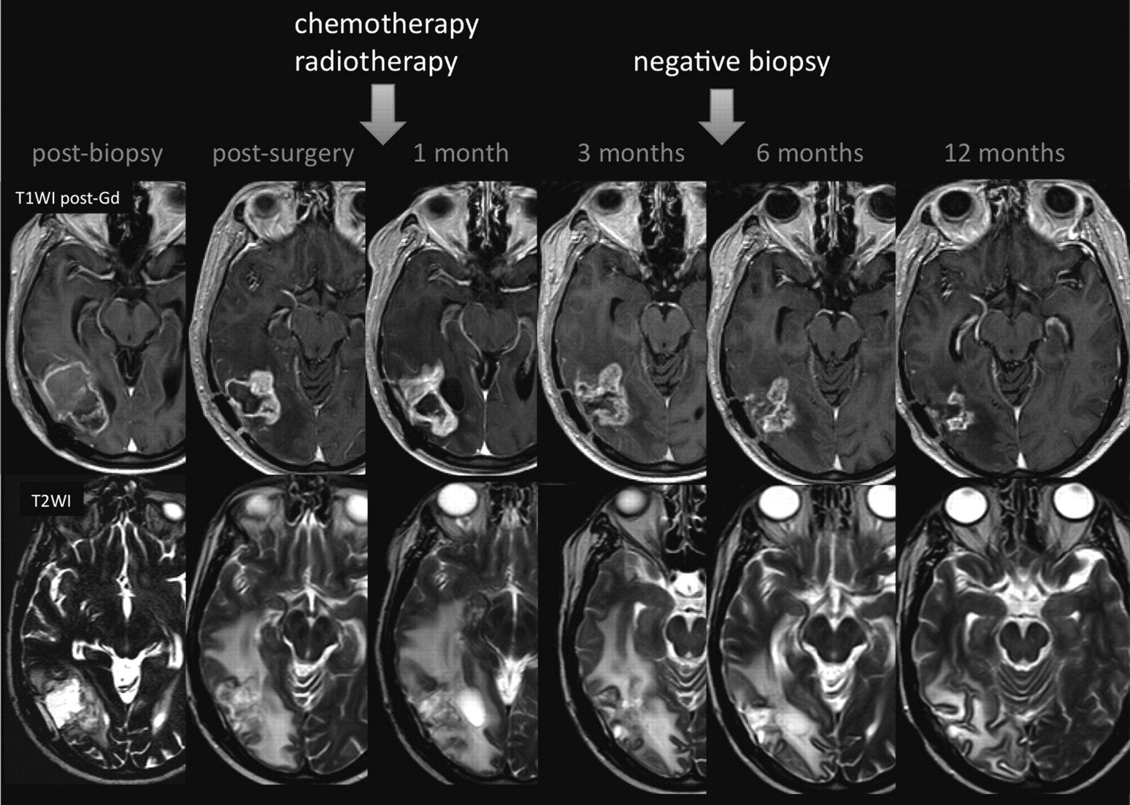

Slide 57
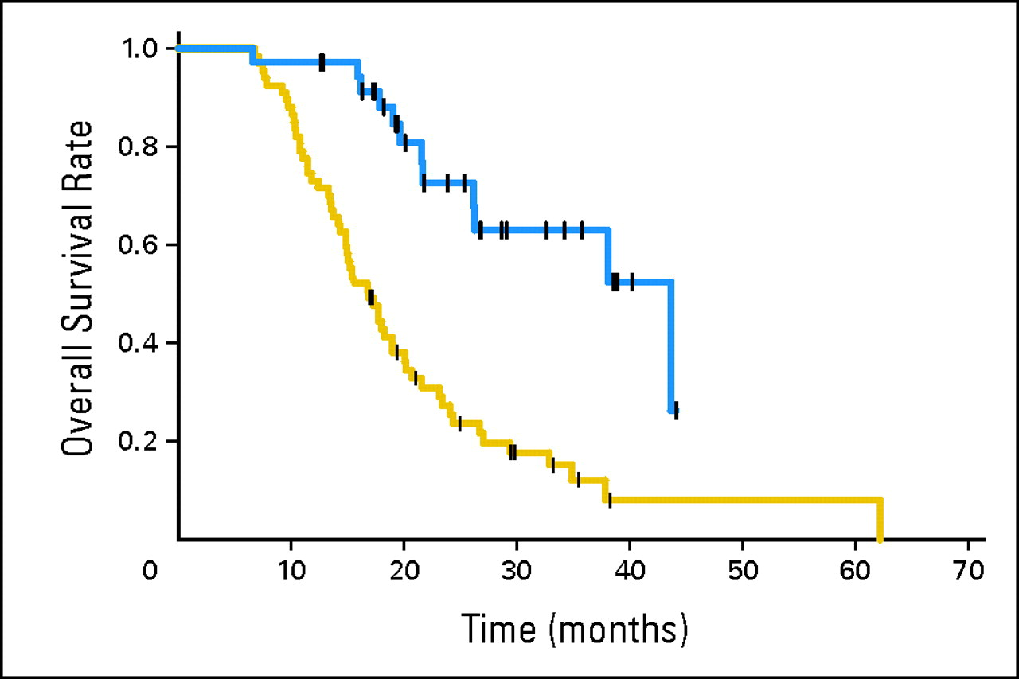
MGMT methylated do better
Fig 2. Overall survival by presence of O6-methylguanine–DNA methyltransferase (MGMT) promoter methylation status. Blue line, patients with methylated MGMT promoter; yellow line, patients with unmethylated MGMT promoter status.
Published in: Alba A. Brandes; Enrico Franceschi; Alicia Tosoni; Valeria Blatt; Annalisa Pession; Giovanni Tallini; Roberta Bertorelle; Stefania Bartolini; Fabio Calbucci; Alvaro Andreoli; Giampiero Frezza; Marco Leonardi; Federica Spagnolli; Mario Ermani; Journal of Clinical Oncology 2008 262192-2197.
DOI: 10.1200/JCO.2007.14.8163
Copyright © 2008

Slide 58
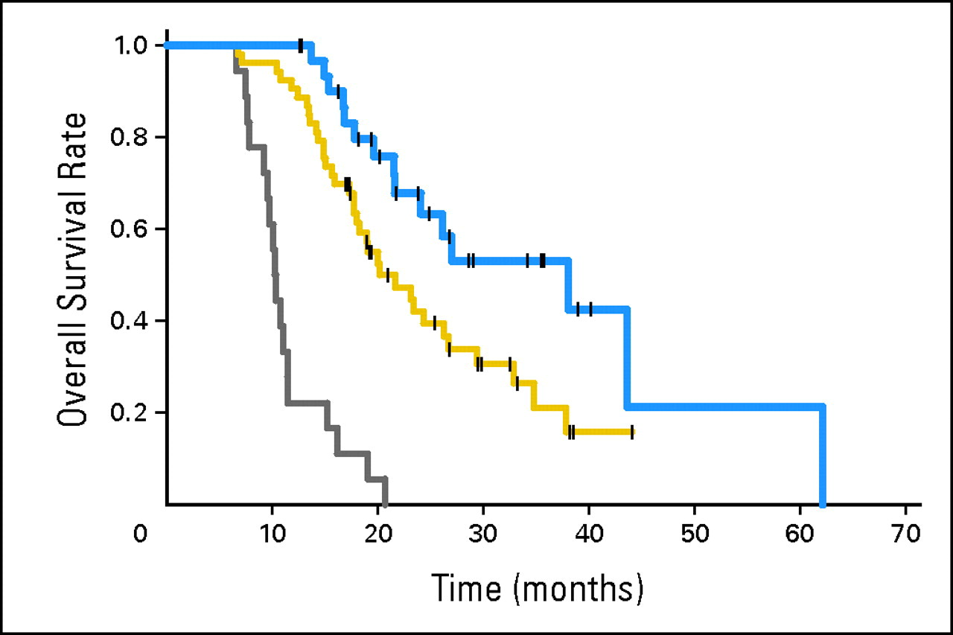
Pseudoprogression do better
Fig 3. Overall survival: blue line, patients with pseudoprogression; gray line, patients with early disease progression; yellow line, patients with neither pseudoprogression nor early disease progression.
Published in: Alba A. Brandes; Enrico Franceschi; Alicia Tosoni; Valeria Blatt; Annalisa Pession; Giovanni Tallini; Roberta Bertorelle; Stefania Bartolini; Fabio Calbucci; Alvaro Andreoli; Giampiero Frezza; Marco Leonardi; Federica Spagnolli; Mario Ermani; Journal of Clinical Oncology 2008 262192-2197.
DOI: 10.1200/JCO.2007.14.8163
Copyright © 2008

Slide 59
RANO Criteria/Response Assessment in Neuro-oncology (Wen et al JCO 2010)
Old Macdonald criteria
25% tumor (2D measure), new lesions, steroids
??
25% psPD pseudoprogression
Contrast enhancement nonspecific
Criteria for determining 1st progression:
1st 12 weeks:
Enhancement beyond 80% IDL (clinical decline ok)
Biospy proven
>3months:
New lesion
Increased steroids
25% increase compared to 1st post xrt scan
If on anti-angiogenic therapy: significant increase in T2/Flair can be considered progression especially if on steroids (pseudoresponse with avastin)
Clinical deterioration
clinical response assessment:
CR: no enhancement for 4 weeks, no steroids
PR: 50% decrease
Stable disesase: no CR, PR or progression
Progression: 25% increase, more T2/FLAIR, clear clinical deterioration
Notes:
Patients have asked me for this treatment off trial ala STOMP
Randomized phase II Trial
Ct/bone scan & 18F or 11C-choline PET-CT or MRI

Slide 60
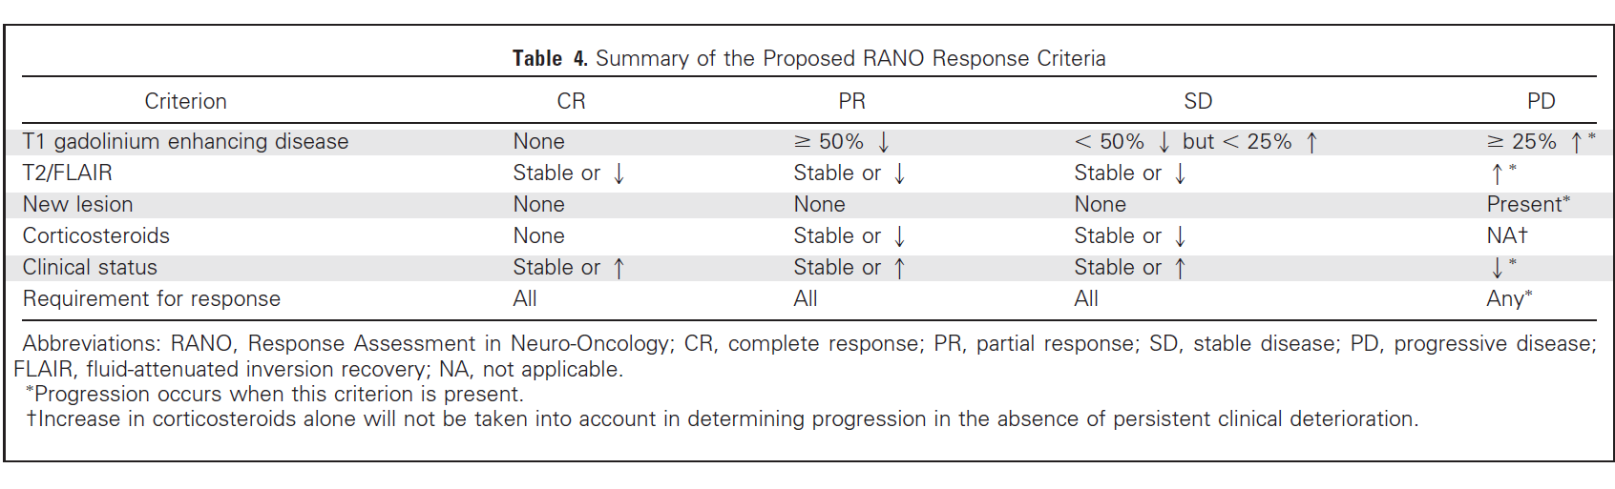
RANO

Slide 61
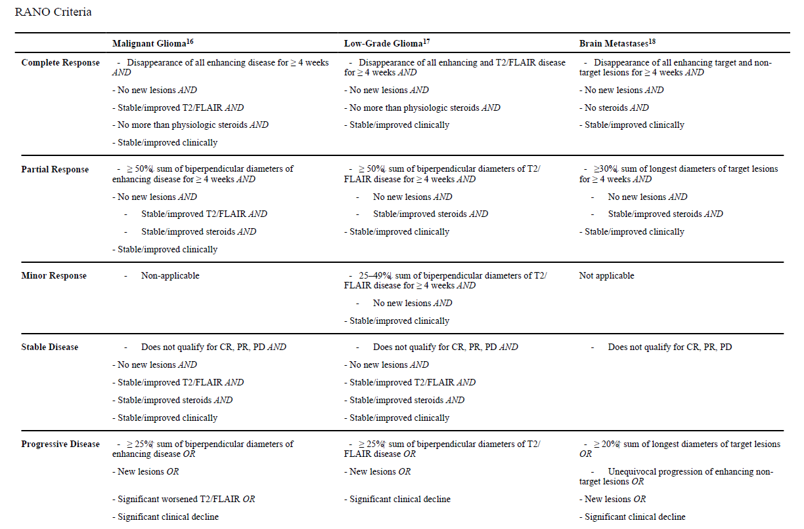

Slide 62
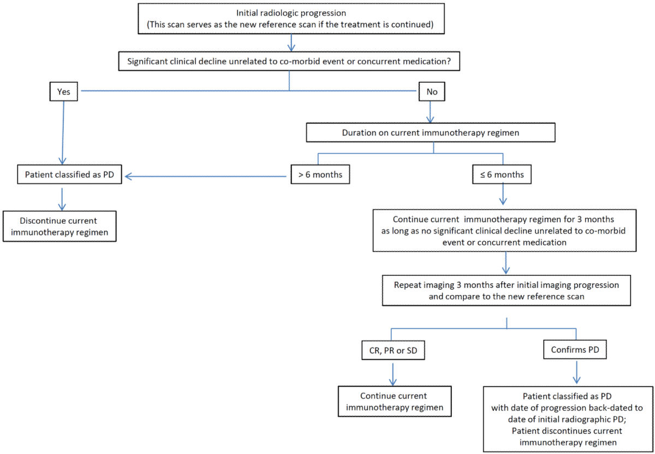
iRANO
Okada et al Lancet Oncol 2015

Slide 63
RTOG 0825: RT+ TMZ +/- Avastin (ASTRO consensus guidelines)
GTV1 = T2/FLAIR abnormality including postop enhancement & surgical cavity
CTV1=GTV1+2cm
PTV1=CTV1+3-5mm = 46Gy
GTV2 (boost)=T1 post abnormality including postop cavity
CTV2=GTV2+2cm
PTV2=CTV2+3-5mm = 60Gy
Modify margin to 0.5cm around natural bariers
>95% PTV receiving 100% Rx
Inhomogeneity +/-10%
Minimal dose 90%

Slide 64
Doses & Volumes
RT Dose | Block Edge Dosimetry Margin* | Source for RT Dose
46 Gy | T2 + 2 cm | RTOG
14 Gy | T1 + 2.5 cm
60 Gy† | T1 + 2-3 cm | EORTC
50 Gy | T2 + 2 cm | NCCTG
10 Gy | T1 + 2 cm
EORTC, European Organization for Research and Treatment of Cancer; Gy, Gray; NCCTG, North Central Cancer Treatment Group; RT, irradiation dose; RTOG, Radiation Therapy Oncology Group; 3D, three-dimensional.
ESTRO consensus
GTV = resection cavity + residual tumor
CTV = GTV + 2 cm
PTV 50 Gy (25 x 2 Gy) = CTV + 0.5 cm
PTV 10 Gy boost (5 x 2 Gy) = GTV + 0.5 cm
MDACC Method: 1981 – at least 2007
Per Chang 2007 IJROBP

Slide 65
In pictures
MDACC RTOG
Notes:
A word about volumes: 80-90% of recurrences are within 2cm of the tumor seen radiographically. In the case of simultaneous integrated boost, MD Anderson practice is to add 2cm to the GTV contour to define that as CTV – this plus a PTV margin gets the PTV1 dose, and the simultaneous integrated boost is prescribed to the GTV + PTV margin. The decision of whether to cover edema is a topic of debate around the country – traditional RTOG volumes have called for edema to be included in the initial volume from which the CTV is expanded. Historically, MD Anderson has not factored edema in to the initial GTV contour – but there is some physician preference and variability.

Slide 67
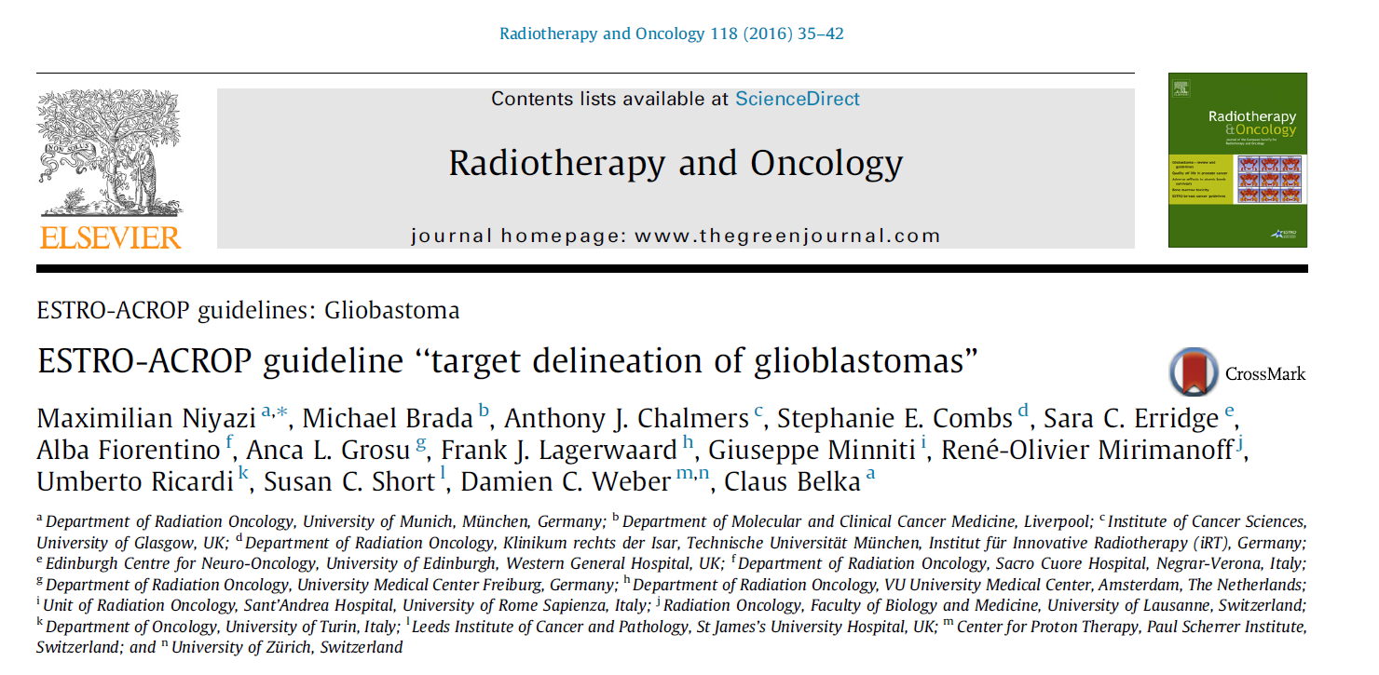

Slide 68
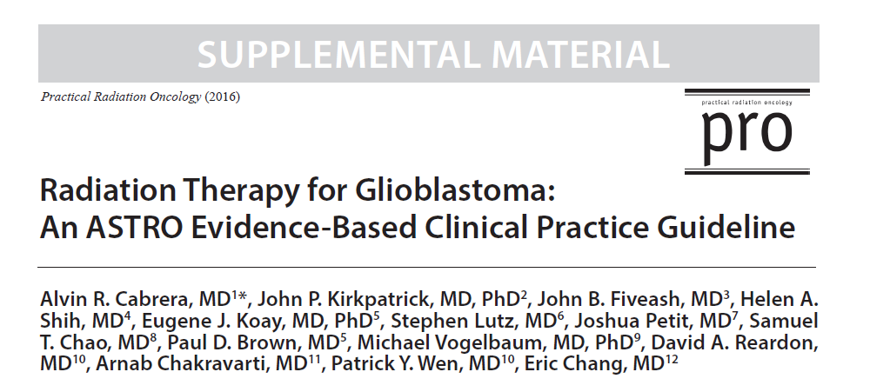

Slide 69
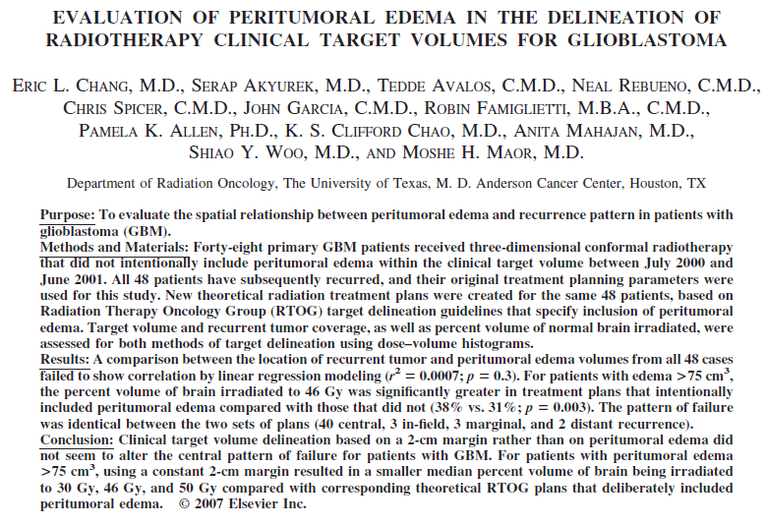
Chang paper: #804

Slide 70
Organs at risk
Critical:
Spinal cord < 45 Gy
Optic nerves, chiasm: max < 54 Gy
Brainstem: max < 54 Gy
Eye < 40 Gy
Retina max < 45
Important;
Brain
Cochlea mean < 45
Lacrimal gland: mean < 26
Parotid: mean< 10
Hippocampus
Pituitary: mean < 36

Slide 71
Skin sparing VMAT (Soltys):
Skin = body – 4mm
Max < 40 Gy

Slide 72
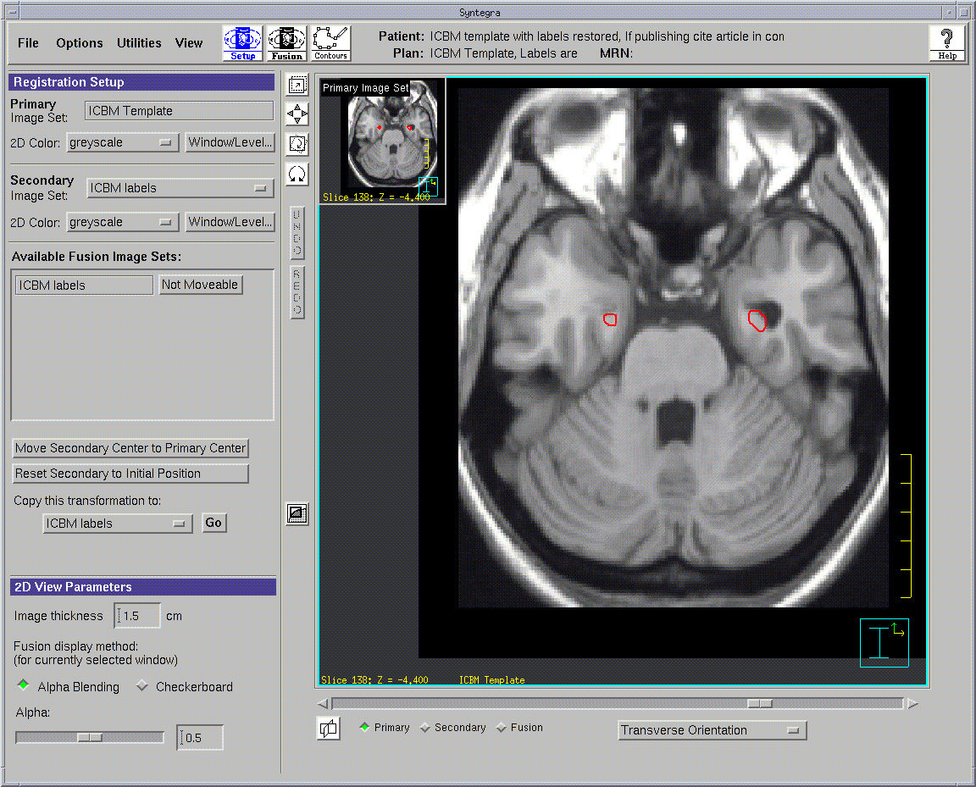
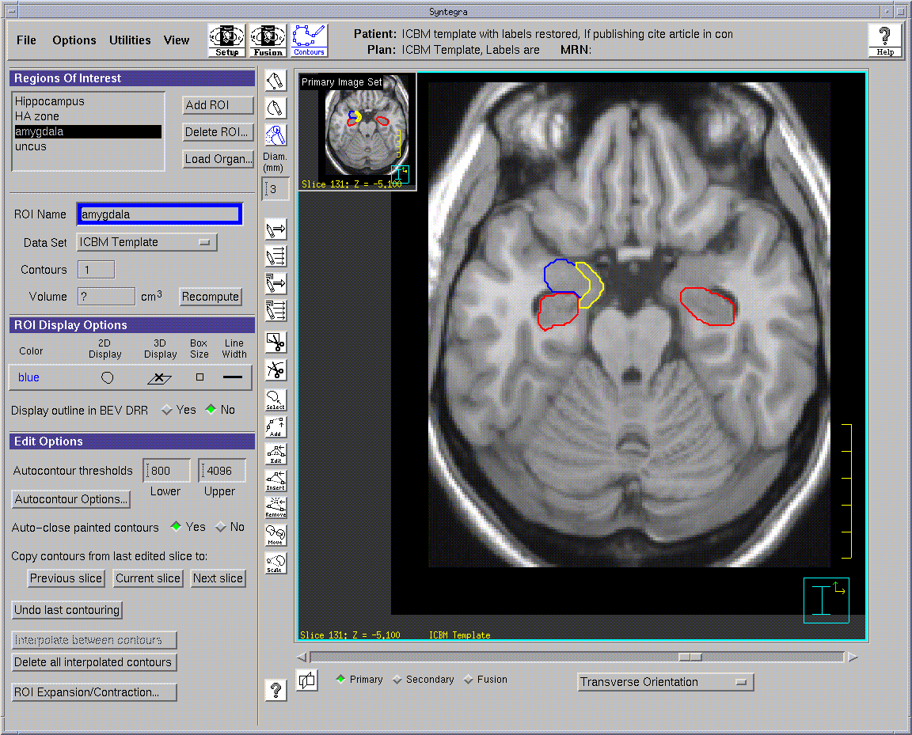
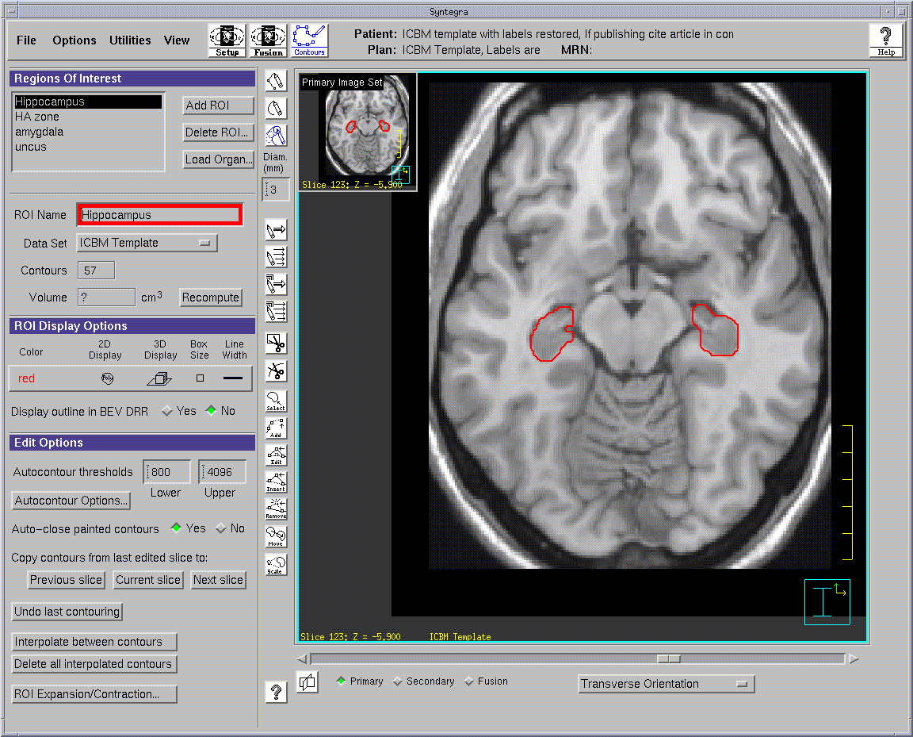
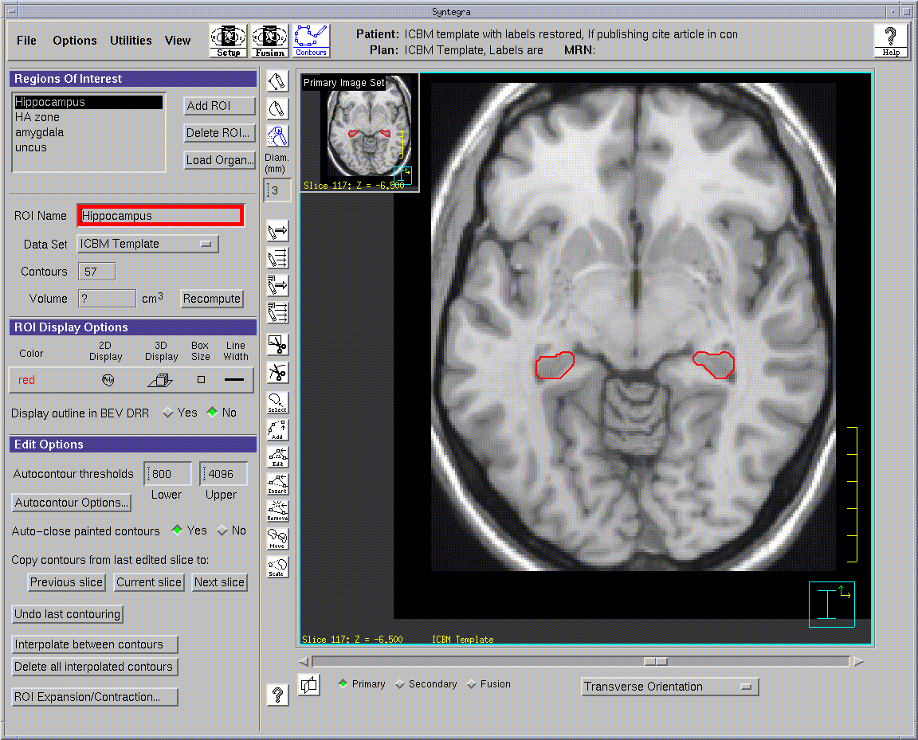
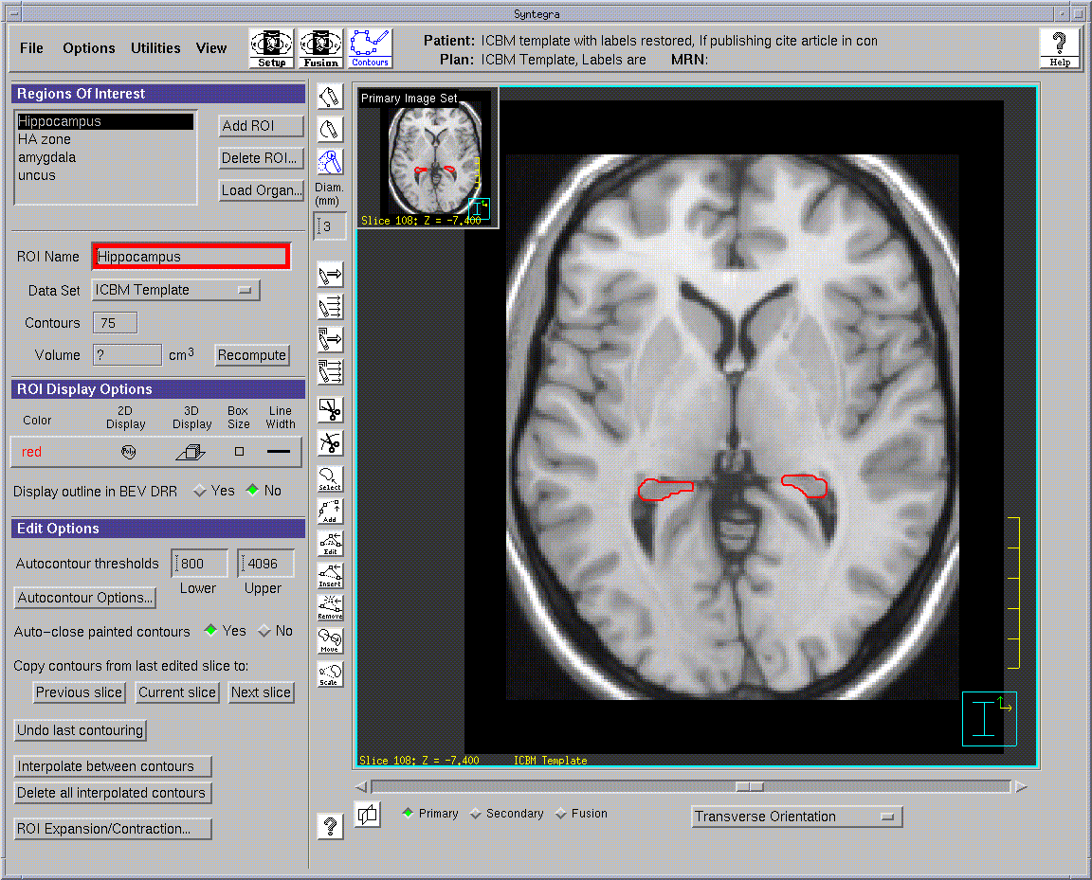
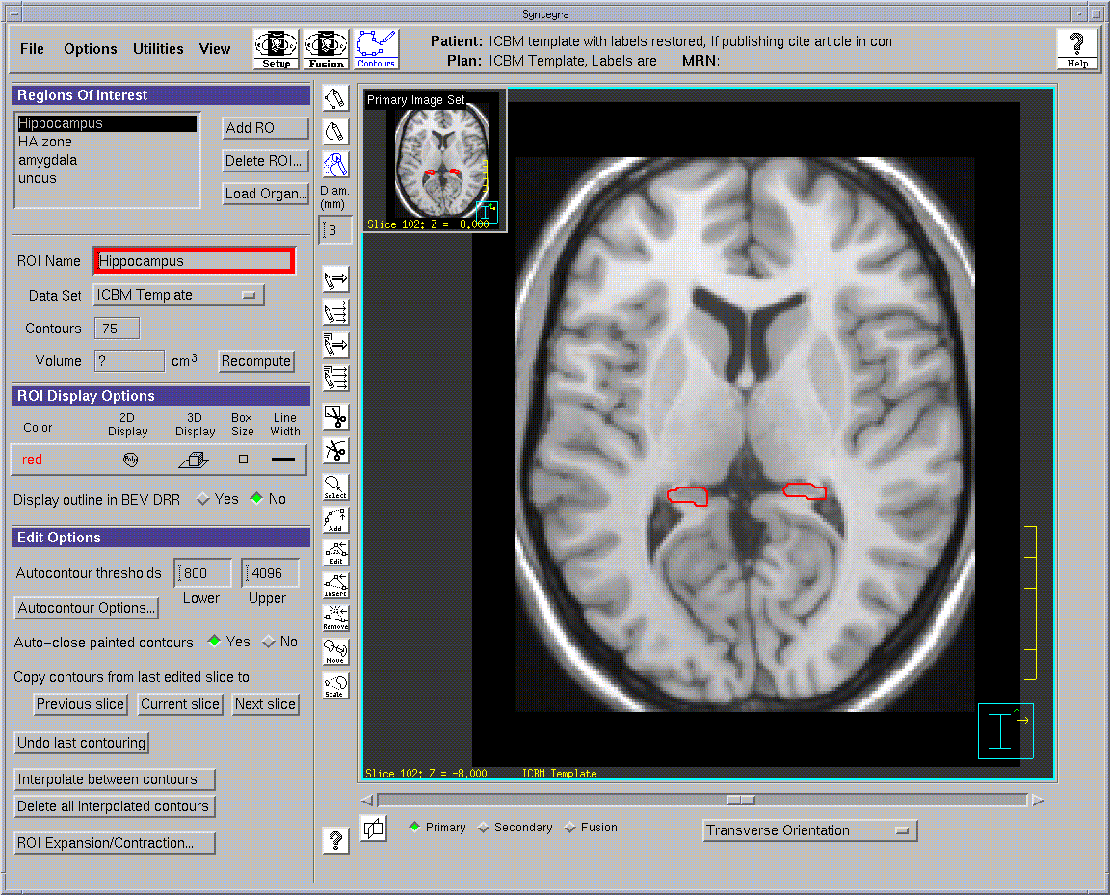
Hippocampal Atlas (RTOG 0933)
Temporal Horn
Amygdala
Uncus
Quadrageminal cistern
Temporal horn of the lateral ventricle
Hippocampal tail
Quadrageminal cistern
Atrium of the lateral ventricle
Splenium
Notes:
Inferiorly to superiorly, stay medial to temporal horn of lateral ventricle (when visible), contour gray matter posteriorly until no longer abuts the border of the atrium of the LV

Slide 73
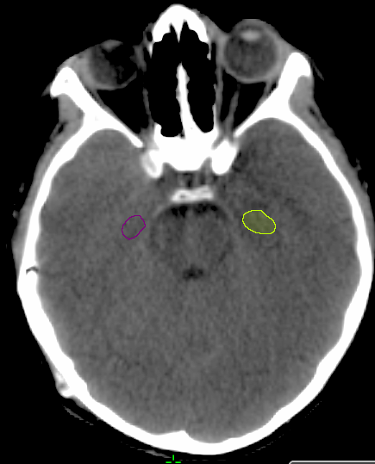




Hippocampus Contour

Slide 74



“Cochlea” Contouring

Slide 75
Justification for 35 Gy/ 10 fx for recurrent GBM
Thomas Jefferson:
Retrospective review of 147 pts that recurred after 60 Gy RT w/ chemo
35 Gy Was well tolerated
Even if recurred in less than 6 months
Good outcomes: median OS 11 months (from recurrence!!)

Slide 76
Recurrent GBM: Management: 35 Gy/10 fx
RTOG 1205
Bevacizumab + RT… vs. bevacizumab
RT = 35 Gy in 10 fx

Slide 77
Recurrent GBM: RTOG 1205: contouring
CTV = GTV (option to add 5mm if tumor < 3.5 cm)
PTV = CTV + institute specific (we typically use 3-5mm)
If want <5mm, must use IGRT
Bevacizumab
Q-2 week infusions
Give 1st infusion alone
Start RT on either the day of, or day after infusion #2
Continue until progression

Slide 78
Bevacizumab
Psuedo-REGRESSION
b/c less vasculature, so less contrast enhancement.
… But tumor sill viable.

Slide 79
Alternative: 30 Gy/ 5fx

Slide 80

SUMMARY – SOLTYS 2016

Slide 81

Halasz ASTRO 2019

